Slide 1
Behavioral Patterns
JS Patterns and Anti Patterns
Malte Brockmann, Jun Heui Cho

Slide 2
Outline
Behavior Pattern in general
Command
Memento
Patterns and Anti Patterns - Behavioral Patterns - Malte Brockmann, Jun Heui Cho - WS 2015

Slide 3
Behavior Pattern in general
Mainly concerned with the communication between objects.
Chain of responsibility
Command
Interpreter
Iterator
Mediator
Memento
Null Object
Observer
State
Strategy
Template method
Visitor
Patterns and Anti Patterns - Behavioral Patterns - Malte Brockmann, Jun Heui Cho - WS 2015

Slide 4
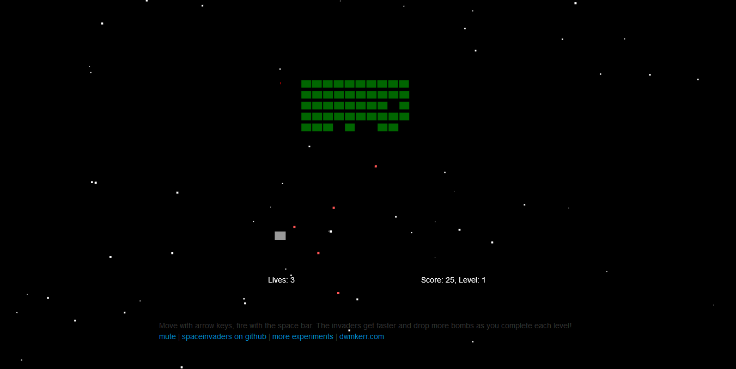
Spaceinvader
Retro Game: shooting Spaceinvader
Level bases
State bases (Welcome-, GameOver-, PlayState, ect.)
Patterns and Anti Patterns - Behavioral Patterns - Malte Brockmann, Jun Heui Cho - WS 2015

Slide 5
Command
Encapsualte a request as an Object
Request without knowing anything about the operation being requestet. - “Black box execute()”
Uses: GUI buttons, Networking, Multi-level undo, Progress bar
Patterns and Anti Patterns - Behavioral Patterns - Malte Brockmann, Jun Heui Cho - WS 2015

Slide 6
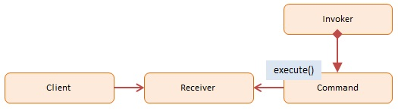
Command - Participans
Client: decides which command at which point
Receiver: knows how to carry out the operatoin
Command: execution()
Invoker: knows how to execute
http://www.dofactory.com/images/diagrams/javascript/javascript-command.jpg
Patterns and Anti Patterns - Behavioral Patterns - Malte Brockmann, Jun Heui Cho - WS 2015

Slide 7
Command - Spaceinvader before
Before:
if(game.pressedKeys[37]) {
this.ship.x -= this.shipSpeed * dt;
}
if(game.pressedKeys[39]) {
this.ship.x += this.shipSpeed * dt;
}
if(game.pressedKeys[32]) {
this.fireRocket();
}
Patterns and Anti Patterns - Behavioral Patterns - Malte Brockmann, Jun Heui Cho - WS 2015

Slide 8
Command - Spaceinvader after 1/2
after:
var goLeft = {
execute : function(obj) {
obj.ship.x -= obj.shipSpeed * dt;
}
}
var goRight = {
execute : function(obj) {
obj.ship.x += obj.shipSpeed * dt;
}
}
var shoot = {
execute : function(obj) {
obj.fireRocket();
}
}
Patterns and Anti Patterns - Behavioral Patterns - Malte Brockmann, Jun Heui Cho - WS 2015

Slide 9
Command - Spaceinvader after 2/2
after:
if(game.pressedKeys[37]) {
goLeft.execute(this);
}
if(game.pressedKeys[39]) {
goRight.execute(this);
}
if(game.pressedKeys[32]) {
shoot.execute(this);
}
Patterns and Anti Patterns - Behavioral Patterns - Malte Brockmann, Jun Heui Cho - WS 2015

Slide 10
Memento
Capturing and externalizing an object’s internal state to be restored later.
Database for “save point”
Use: used to avoid disclosure of implemetnation details
Patterns and Anti Patterns - Behavioral Patterns - Malte Brockmann, Jun Heui Cho - WS 2015

Slide 11
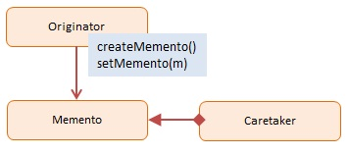
Memento - Participans
Originator: Interface to create and restore mementos
Memento: Ordinator object
Caretaker: stores mementos
http://www.dofactory.com/images/diagrams/javascript/javascript-memento.jpg
Patterns and Anti Patterns - Behavioral Patterns - Malte Brockmann, Jun Heui Cho - WS 2015

Slide 12
Memento - Spaceinvader before 1/3
before:
WelcomeState.prototype.keyDown = function(game, keyCode) {
[…]
game.moveToState(new LevelIntroState(game.level));
};
[…]
GameOverState.prototype.keyDown = function(game, keyCode) […]
game.moveToState(new LevelIntroState(1));
}
Patterns and Anti Patterns - Behavioral Patterns - Malte Brockmann, Jun Heui Cho - WS 2015

Slide 13
Memento - Spaceinvader after 2/3
after:
function Memento(state){
this.state = state;
this.getSavedState = function(){
return this.state;
};
};
function Caretaker(){
var saveState = [];
this.addMemento = function(memento){
saveState.push(memento);
};
this.getMemento = function(index){
return saveState[index];
};
};
Patterns and Anti Patterns - Behavioral Patterns - Malte Brockmann, Jun Heui Cho - WS 2015

Slide 14
Memento - Spaceinvader after 3/3
after:
caretaker = new Caretaker();
[…]
WelcomeState.prototype.keyDown = function(game, keyCode) {
[…]
caretaker.addMemento(new Memento(new LevelIntroState(game.level))); game.moveToState((caretaker.getMemento(0)).getSavedState())
}
};
[…]
GameOverState.prototype.keyDown = function(game, keyCode) {
[…]
game.moveToState((caretaker.getMemento(0)).getSavedState());
}
};
Patterns and Anti Patterns - Behavioral Patterns - Malte Brockmann, Jun Heui Cho - WS 2015

Slide 15
Sources
http://www.dofactory.com/javascript/design-patterns
https://sourcemaking.com/design_patterns
https://en.wikipedia.org/wiki/Command_pattern
https://de.wikipedia.org/wiki/Memento_%28Entwurfsmuster%29
(Osmani, A. (2012). Learning JavaScript Design Patterns. O'Reilly Media, Inc.)
Patterns and Anti Patterns - Behavioral Patterns - Malte Brockmann, Jun Heui Cho - WS 2015

